Slide 1
ZeroR and OneR Classifier
DR. SIFAT MOMEN

Slide 2
Announcements
Do carry calculators in the class from now on.
Scientific Calculator

Slide 3
Classifier (Recall)
Supervised learning contains (X, y)
X is the data comprising of instances with attributes <x₁, x₂, ….. x_{n}> (n featured attribute)
y is the label
If y is discrete/categorical, then the problem is a classification problem and we require a classifier to classify.
If y is continuous, then the problem is a regression problem

Slide 4
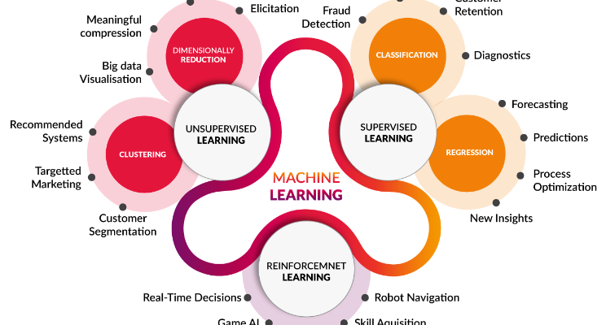
Machine Learning (Recall)

Slide 5
Categorical/Discrete variables
A categorical/ discrete variable is one that has two or more categories (values).
There are two kinds of categorical variable
Nominal
A nominal variable has no intrinsic ordering to the categories.
E.g. a gender is a categorical variable with values {Male, Female} that have no intrinsic ordering to the categories
Ordinal
An ordinal data has clear ordering.
E.g. Temperature = {low, medium, high}

Slide 6
ZeroR classifier
ZeroR stands for Zero Rule
Simplest classification method that relies on the target and ignores all predictors.
ZeroR classifier simply predicts the majority category.
Although there is no predictability power in ZeroR, it is useful in determining a baseline performance as a benchmark for other classification methods.
Algorithm
Construct a frequency table for the target and select the most frequent value.

Slide 7
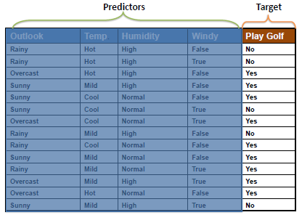
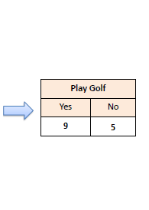
ZeroR classifier

Slide 8
Model Evaluation
Models need to be evaluated and therefore some kind of model evaluation techniques need to be in place.
Confusion Matrix
A confusion matrix shows the number of correct and incorrect predictions made by the classification model compared to the actual outcomes (target value) in the data.
The matrix is N × N, where N is the number of classes in the target variable.

Slide 9
Terminologies (Related to Confusion Matrix)
Accuracy: The proportion of the total number of predictions that were correct.
Positive Predictive Value or Precision: The proportion of positive cases that were correctly identified.
Negative Predictive Value: The proportion of negative cases that were correctly identified.
Sensitivity or Recall: The proportion of actual positive cases which are correctly identified.
Specificity: The proportion of actual negative cases that are correctly identified.

Slide 10
2 × 2 Confusion Matrix for two classes (Positive and Negative)
Confusion Matrix |  | Target
 |  | Positive | Negative
Model | Positive | a | b | Positive Predicted value | a/(a+b)
 | Negative | c | d | Negative Predicted Value | d/(c+d)
 |  | Sensitivity | Specificity | Accuracy = (a+d)/(a+b+c+d)
 |  | a/(a+c) | d/(b+d)
a = True Positive (TP)
b = False Positive (FP)
c = False Negative (FN)
d = True Negative (TN)

Slide 11
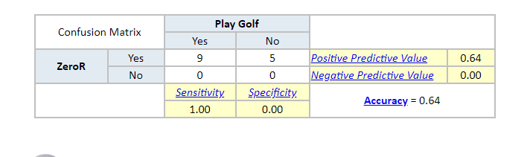
Confusion Matrix of the ZeroR Classifier for the “play golf” dataset

Slide 12
OneR Classifier
OneR stands for “One Rule”
A simple, yet accurate, classification algorithm that generates one rule for each predictor in the data, then selects the rule with the smallest total error as its “one rule”.
OneR Algorithm:
For each predictor, For each value of that predictor, make a rule as follows; Count how often each value of target (class) appears Find the most frequent class Make the rule assign that class to this value of the predictor Calculate the total error of the rules of each predictor Choose the predictor with the smallest total error.

Slide 13
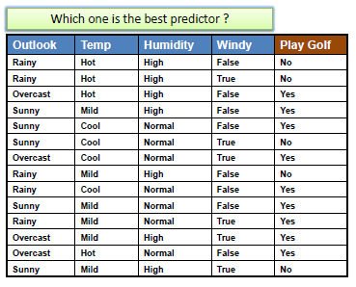
OneR classifier

Slide 14
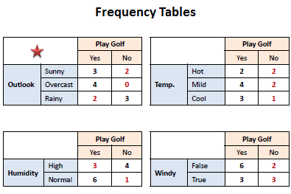
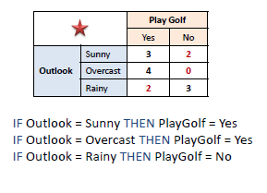
OneR classifier

Slide 15
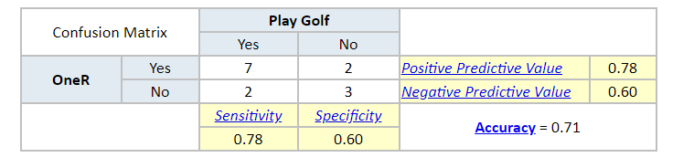
Model Evaluation (OneR classifier)

Slide 16
WEKA
Weka is a collection of machine learning algorithms for data mining tasks.
It contains tools for data preparation, classification, regression, clustering, association rules mining, and visualization.
Weka supports deep learning!
Built in Java
Link: https://www.cs.waikato.ac.nz/ml/weka/

Slide 17
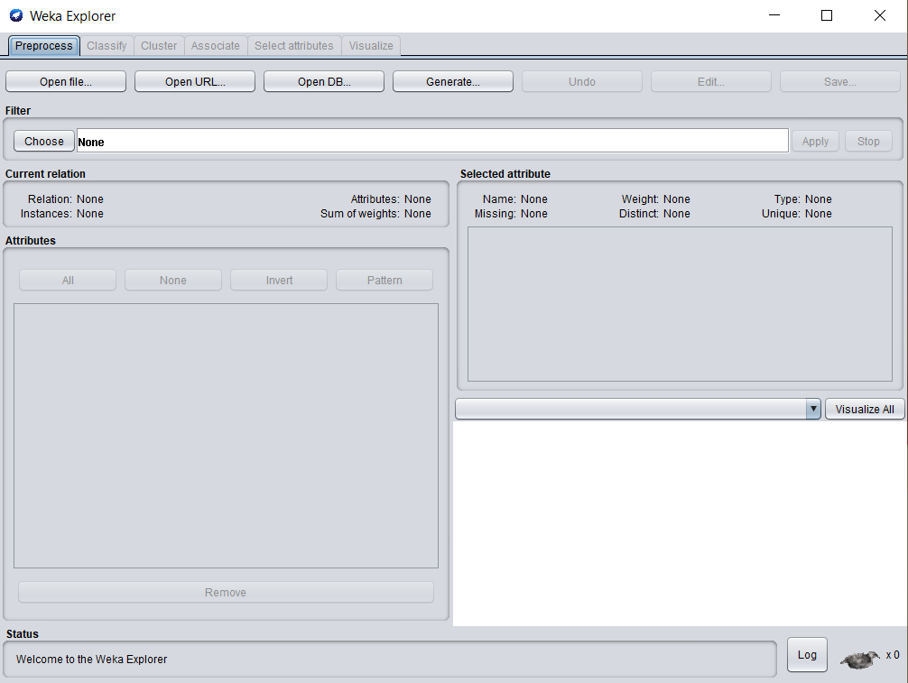

Weka Explorer

Slide 18
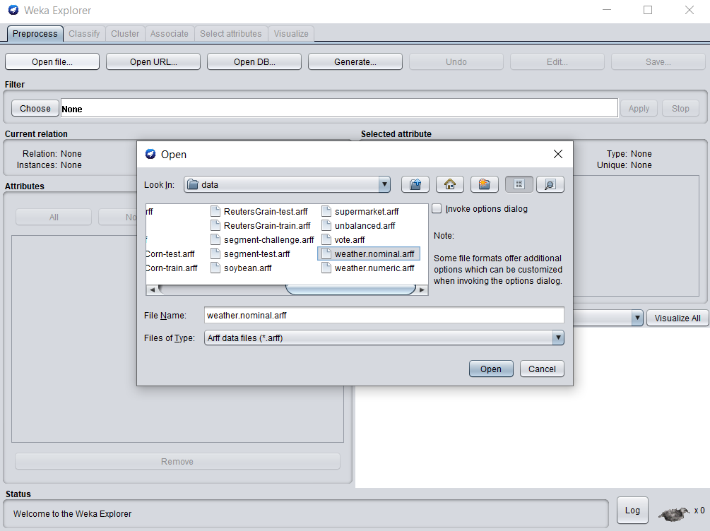
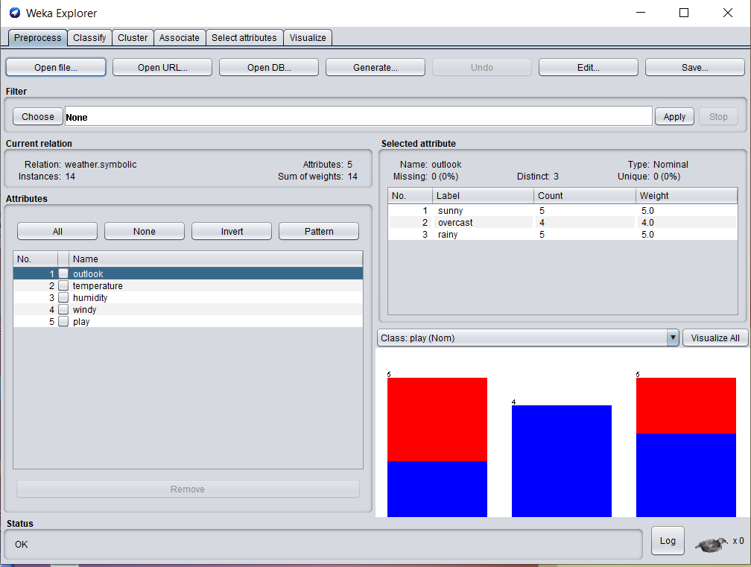
Weka File Selection

Slide 19
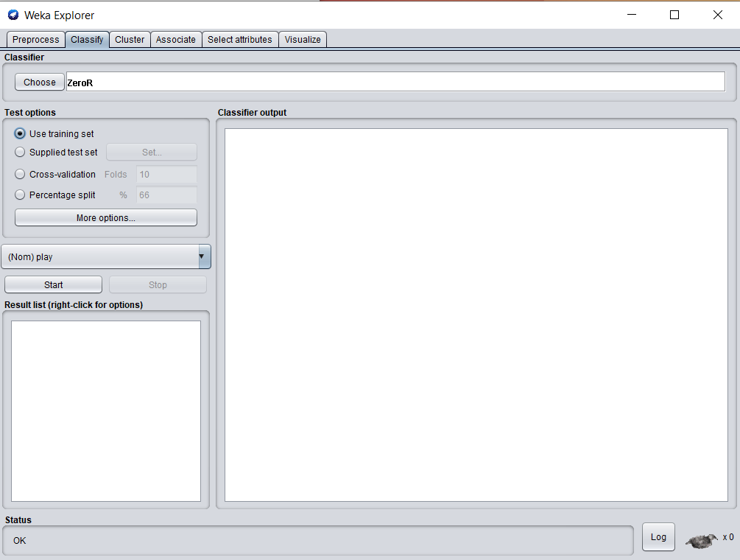
Weka

Slide 20
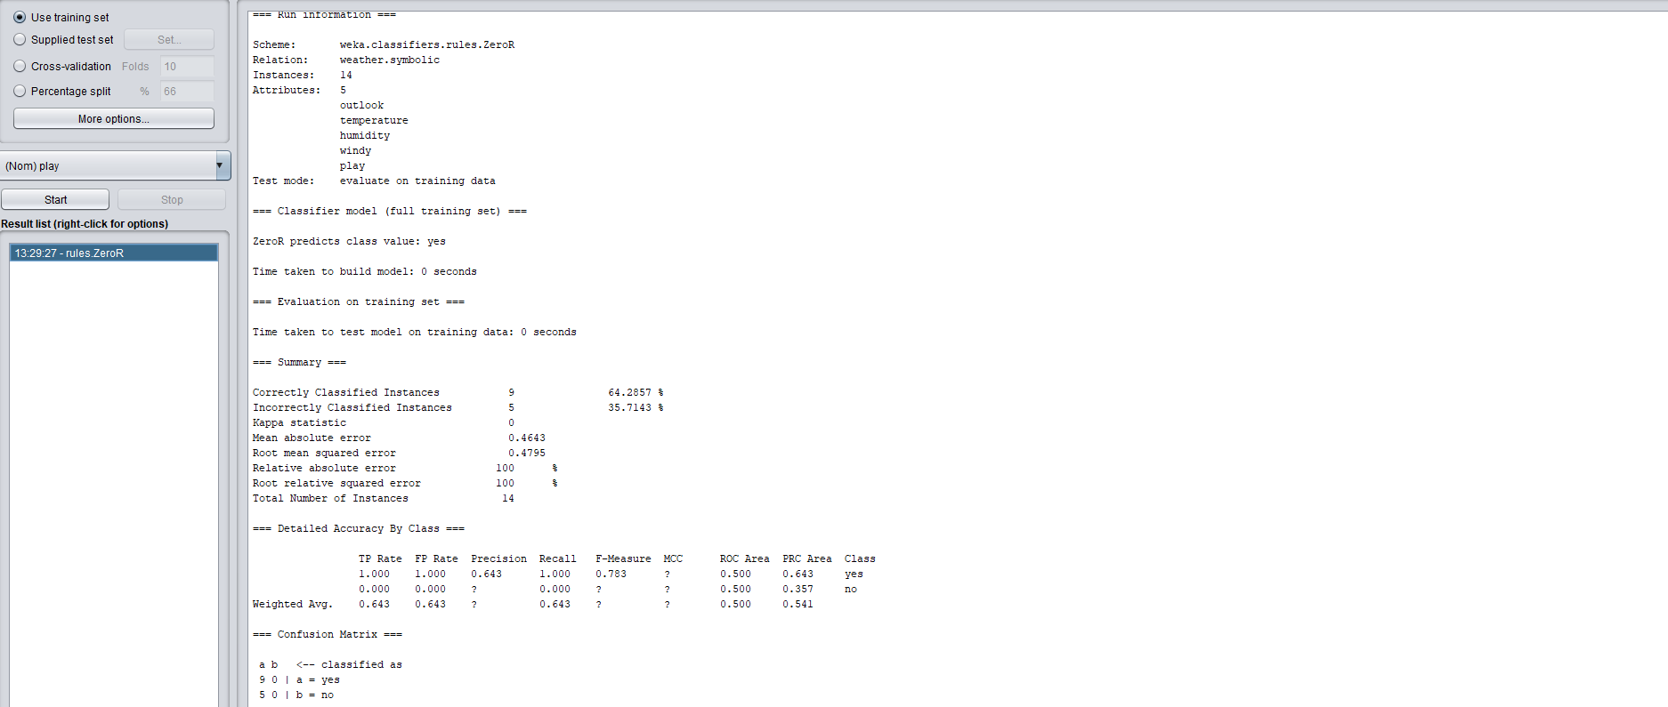
Weka Results

Slide 21
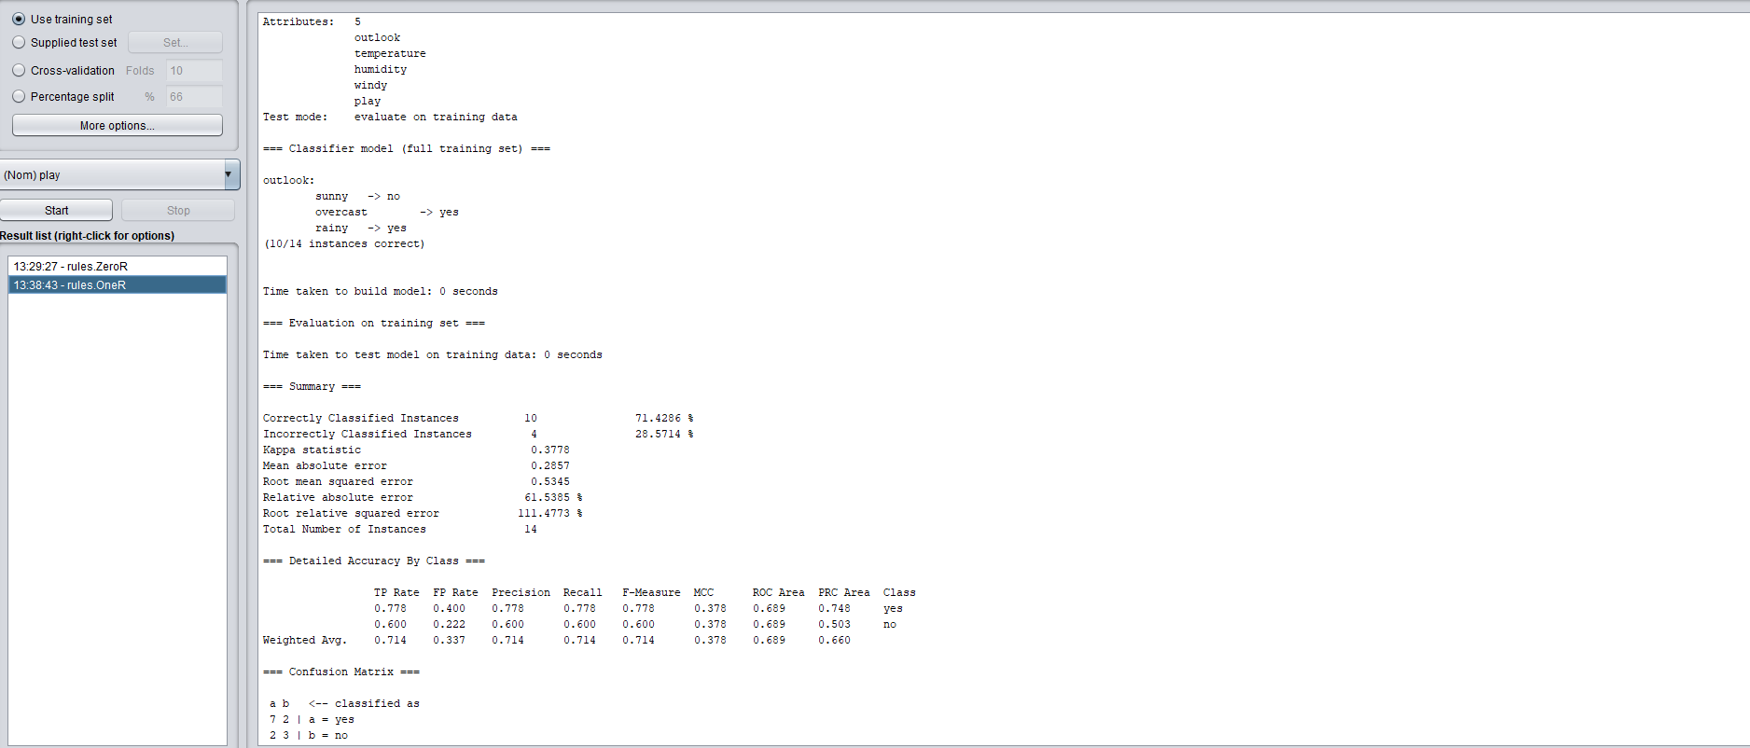
Weka Results

Slide 22
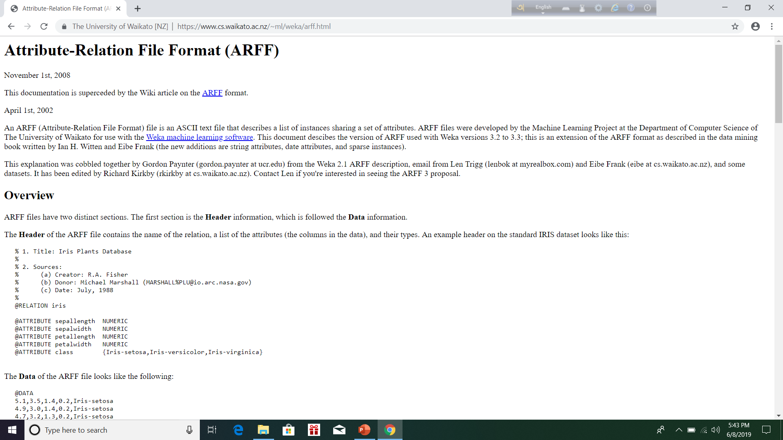

Slide 23
Machine learning in Python
Scikit-learn: Free, software machine learning library for Python programming language
Pandas: Software library written for Python programming language for data manipulation and analysis.
Matplotlib: A plotting library for Python programming language
Numpy: LIbrary for Python programming language which is used for working with arrays and matrices

Slide 24
ZeroR classifier using Python
imports
from sklearn.dummy import DummyClassifier
from sklearn.metrics import accuracy_score
from sklearn.metrics import confusion_matrix
from sklearn.metrics import classification_report
import pandas as pd

Slide 25
ZeroR classifier using Python
Reading dataset
df = pd.read_csv('E:\ML-teaching\Sample Datasets\weather.csv')
Try the following
print(df)
print(df.shape)
print(df.head())
print(df.describe())

Slide 26
ZeroR classifier using Python
Separate X and y
X = df.drop(columns = ['Play'])
y = df['Play']

Slide 27
ZeroR classifier using Python
Train and Test
model = DummyClassifier(strategy = 'most_frequent', random_state = 0)
model.fit(X,y)
predictions = model.predict(X)
score = accuracy_score(y, predictions)
print(score)
print(confusion_matrix(y, predictions))
print(classification_report(y, predictions))

Slide 28
Future
We should ideally divide the dataset into train set and test set
Train set should be used to create the model
Test set should be used to test how well the model is predicting unlabel cases.

